Slide 1
Increase Testability with Code Seams
Good testers can do amazing things with your code. Great testers cheat.
Let’s explore how to change code to make it very easy to test. Let’s show how to cheat and how to realize when we should be cheating.
We are going to look at lot’s of examples of tests to get a design sense of when you should be cheating, then go into 1 or 2 examples of how to make those cheats a reality.

Slide 2
Increase Testability with Code Seams
@LlewellynFalco

Slide 3

Seams

Slide 4

Battery testing

Slide 5
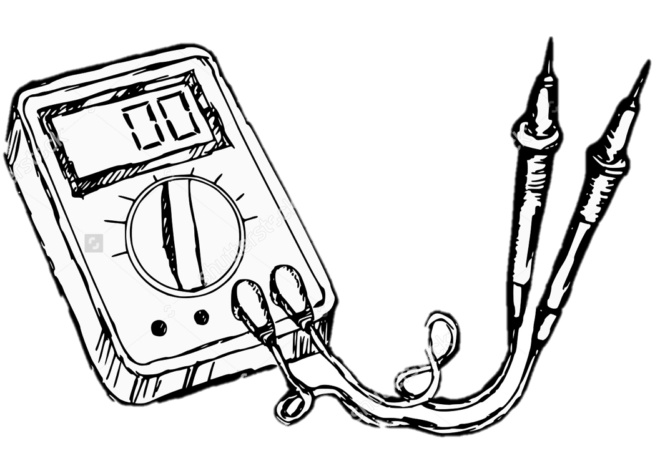
Battery testing

Slide 6
Why is Testing Hard?
Setup
Lot’s of paths
Global state
Lot’s of clutter
Environment
Uncontrollable Variables
UI
Money
Dates
Mobile
Database
Integration
Wait Times
XPath
Finding Elements
Timing
Failure cases

Slide 7
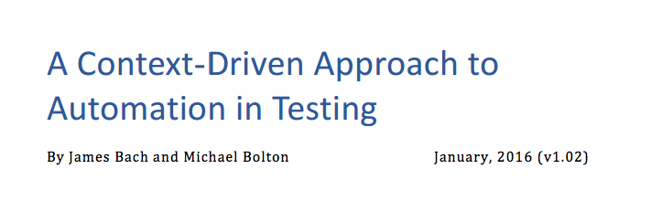
Automated checking is a tactic of testing, and can have considerable value...
…Checking through an API beneath the GUI level can be particularly useful.
In designing such low-level checks, programmers and testers can profitably work together.
We are more doubtful of automated checking at the GUI level. GUIs are notoriously fussy.

Slide 8
CASE #3: Automated checking.
We wanted to demonstrate full-on automated checking, while at the same time staying with the FocusWriter example. FocusWriter does not provide an API for testing, which required us to automate through the GUI, and so the
headaches began.

Slide 9
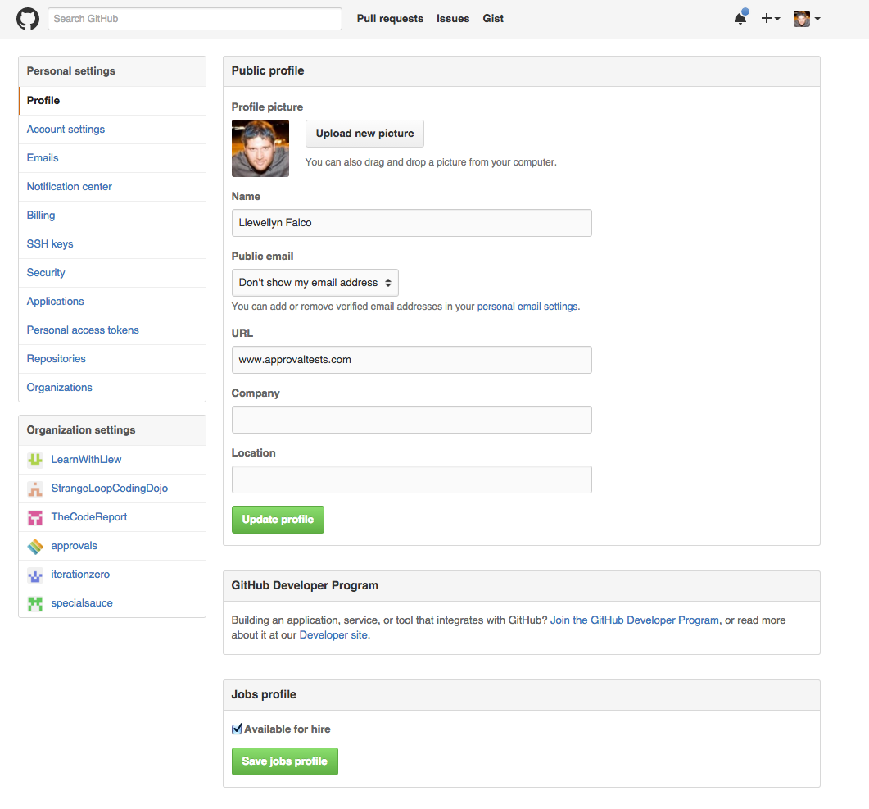
Testing Edit Profile

Slide 10
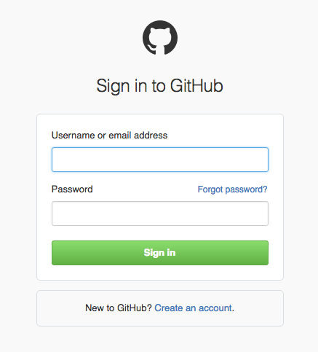
?
?
?
?
Testing Edit Profile

Slide 11
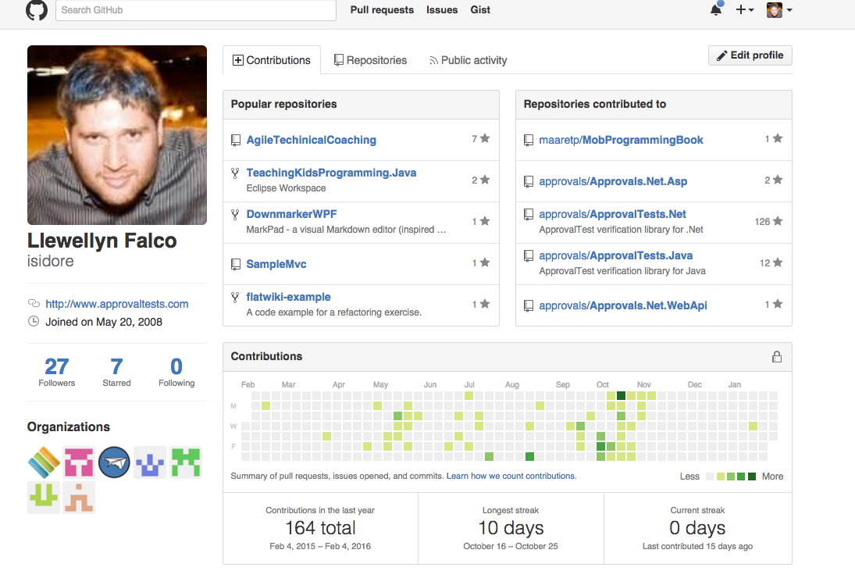
Testing Edit Profile

Slide 12
https://github.com/login
?return_to=https://github.com/settings/profile
&user_name=isidore
&password=Password123
ByPass Login

Slide 13
https://github.com/EditProfile/
?data={“Name”: “Llewellyn Falco”, “photo”:”http://”….}
ByPass EVERYTHING

Slide 14
Testing Pyramid
Slow
1-5%
Medium
5-15%
Fast
80-90%

Slide 15
By.xpath("//div[@class='canvas- graph']//div[contains(text(),Location)][input]/following-sibling::h4”)
Testing Edit Profile

Slide 16
By.id(”locatation_input”)
Testing Edit Profile

Slide 17
DarkFunction Editor Test
1. Open df editor
2. Find File -> Find New -> Find Animation set
3. Navigate to github -> dark function editor ->
Testing Resources -> StarWarsImages -> SWAII.sprites
4. Open
5. Add animation
6. Add animation (1)
7. Add animation (2)
8. Rename animation 1 -> animation a
9. add animation
10 . find animation 3 confirm exists.

Slide 18
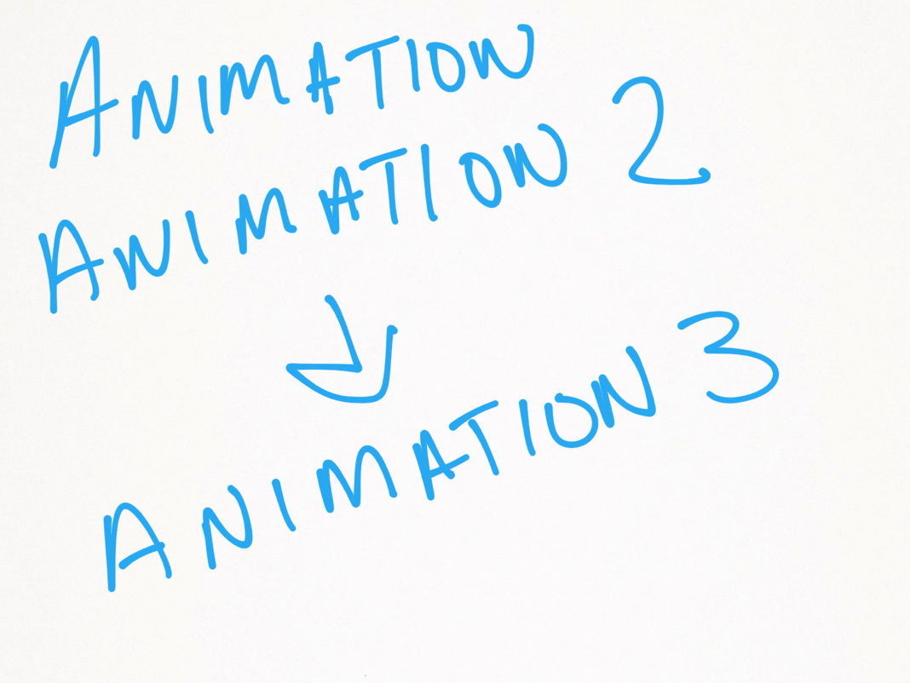
DarkFunction Unique Name

Slide 19
DarkFunction Unique Name
Given animation names: animation, animation 2
When I ask for a new name
Then I get animation 3

Slide 20
DarkFunction Editor Test
1. Open df editor
2. Find File -> Find New -> Find Animation set
3. Navigate to github -> dark function editor ->
Testing Resources -> StarWarsImages -> SWAII.sprites
4. Open
5. Add animation
6. Add animation (1)
7. Add animation (2)
8. Rename animation 1 -> animation a
9. add animation
10 . find animation 3 confirm exists.
VS.
Notes:
***************************
* GIT *
***************************
git checkout 8918da8

Slide 21
DarkFunction Editor Seams

Slide 22
Functional
All inputs in
Deterministic
All results out

Slide 23
NON-Functional
Get inputs as needed (global state, file, database…)
Result vary (dates, random, environment)
Store results (global, disk, database, transient)

Slide 24
All inputs in
public double calculate(double amount)
{
int step1 = (int) (amount * 2);
double step2 = step1 * 1.5;
return step2;
}
Deterministic
All results out

Slide 25
All inputs in?
public int Advance()
{
return steps++;
}

Slide 26
All inputs in?
public int age(DateTime birthDate)
{
var timeSpan = DateTime.Now - birthDate;
var age = DateTime.MinValue + timeSpan;
return age.Year-1;
}
Deterministic?

Slide 27
All results out?
public void saveFile(Person info, string fileName)
{
File.WriteAllText(fileName, info.ToString());
}

Slide 28
Why functional is easier for tests
Unit Test
Production Code
Do
Verify

Slide 29
Why functional is easier for tests
Unit Test
Functional Harness
Production Code
Do
Verify

Slide 30
public static Output function(inputs)

Slide 31
Steps
Determine functional parts
Separate
Extract
Compare against intention

Slide 32
Separating functional Pieces
List
Non-Functional
Functional

Slide 33
Separating functional Pieces
List
Non-Functional
List2
Functional

Slide 34
Peel
*http://lfal.co/PeelAndSlice

Slide 35
return sample
SLICE
*http://lfal.co/PeelAndSlice

Slide 36
Why is Testing Hard?
XPath
Finding Elements
Global state
Dates
Failure cases
Wait Times
Mobile
Setup
Lot’s of paths
Environment
Uncontrollable Variables
UI
Money
Dates
Database
Integration
Finding Elements
Timing

Slide 37
Fix: Global State

Slide 38
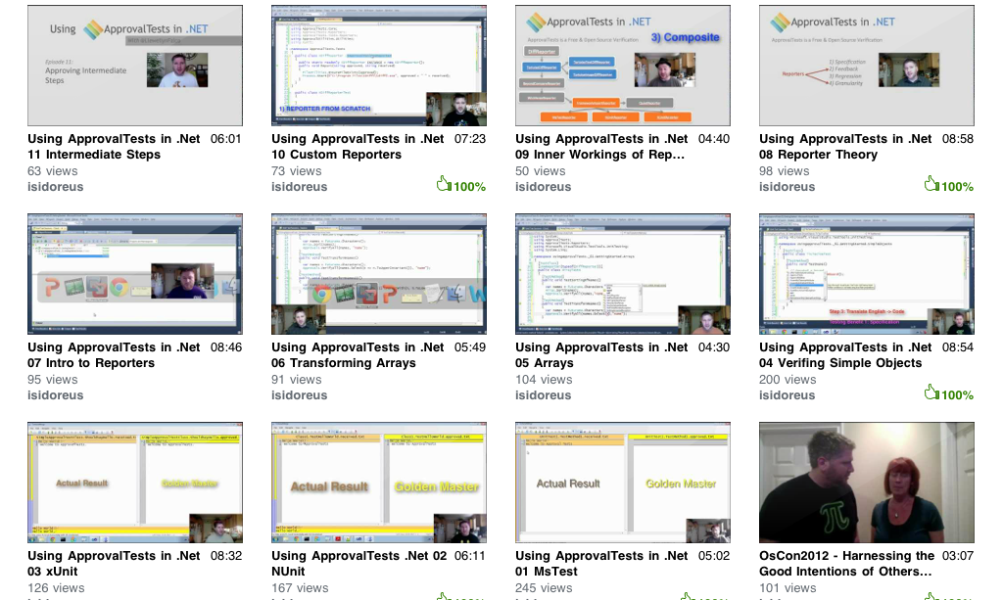
Resources
www.ApprovalTests.com
21 episode youtube series
Notes:
Both

Slide 39
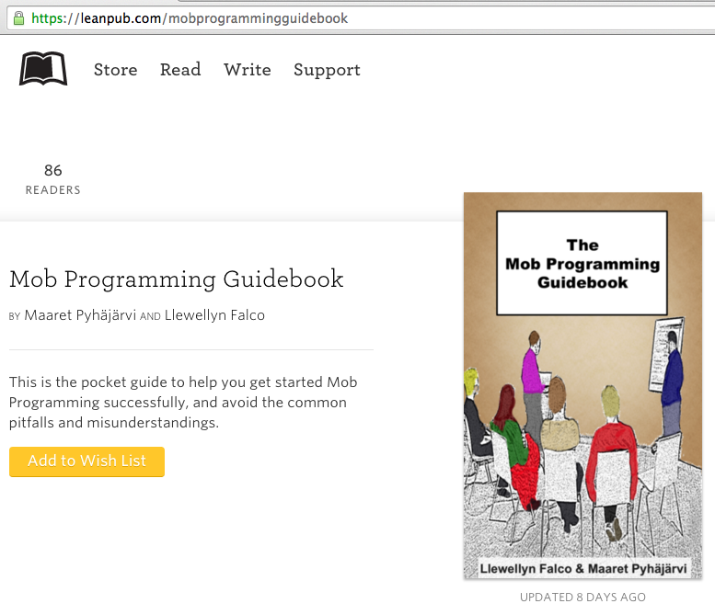
#MobProgrammingGuidebook

Slide 40

Contact Information
@LlewellynFalco http://LlewellynFalco.Blogspot.com
http://www.approvaltests.com
Notes:
Both

